Slide 1
Big Mountain Resort Pricing Analysis
by Richard Harrison

Slide 2
Problem Identification
Ensure Big Mountain is pricing their tickets appropriately
Consider ways to increase revenue or cut costs
Analyze viability of spending $1,540,000 on a lift

Slide 3
Recommendation and Key Findings
Adding the lift (with addition of adding a run) will increase ticket value by $1.99
With expected 350k visitors, this will bring ~$3.5 million in revenue, ~$2 million profit in first year
Consider closing 1-2 unrelated runs as this won’t decrease ticket value and ideally cut costs

Slide 4
Modeling Results and Analysis
Data wrangling to ensure valuable data/features, no missing values etc.
Normalization of features across states with various populations and skiable area etc.
Chose weekend ticket prices as target with several features

Slide 5
Modeling Results and Analysis
Started with a baseline prediction (the average), a linear model and a random forest regressor
Used multiple evaluation metrics including R2, MAE, MSE and RMSE
Opted for random forest as it performed the best with MAE of $9.5 on test data set

Slide 6
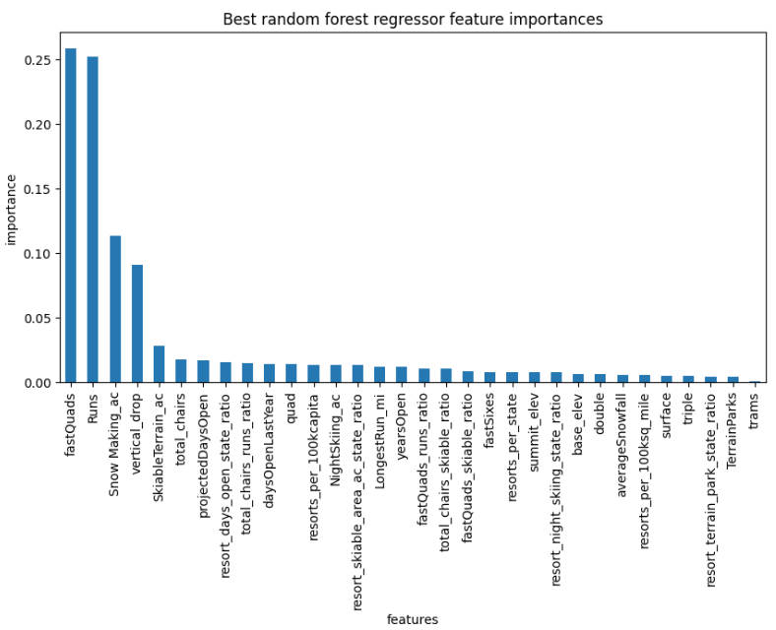
Modeling Results and Analysis
The graph shows feature importance scores according to the random forest model
Generally make intuitive sense
fast lifts, number of runs, area covered with snow and vertical drop distance are highly valuable and predictive of ticket prices

Slide 7
Summary and Conclusion
The modeled ticket price for Big Mountain was $95.87 with an expected MAE of $10.39 and actual price of $81 means there’s probably room for increasing ticket prices
Adding a lift (and additional run) will increase ticket value by another $1.99 (~$3.5 million revenue with 350k visitors)
With cost of ~$1.5 million, it makes sense to add the lift yielding an additional $2 million in profit and adding value to tickets
Potential for cutting 1-2 runs as well, no predicted decrease in ticket value

